Slide 1
HANOI UNIVERSITY
READING TERM 01
LESSON 01: LIFE IN A DAY
Teacher: Quang Dang (M.A)

Slide 2
ABOUT ME
  BA English Studies, Hanoi University, VN.
  MA TESOL, Nottingham Trent University, UK.
  Teacher of English since 2019.

Slide 3

PEOPLE LEAVE PHOTOS OF THEMSELVES ON A WALL AT THE PANDA POST OFFICE IN CHENGDU, CHINA:
QUESTIONS FOR DISCUSSION:
LOOK AT THE PHOTO AND READ THE CAPTION
WHAT DO YOU TAKE PHOTOS OF ON A TYPICAL DAY? WOULD YOU LIKE TO ADD PHOTOS TO THIS WALL?
WHICH DAY OF THE WEEK DO YOU LIKE BEST? WHICH DAY OF THE WEEK DO YOU LIKE LEAST? WHY.

Slide 4

LOOK AT THE PHOTO AND ANSWER
How many people move to a new city everyday? How many use a cellphone?
Do you use social media everyday? What kinds of things do you use it for?

Slide 5
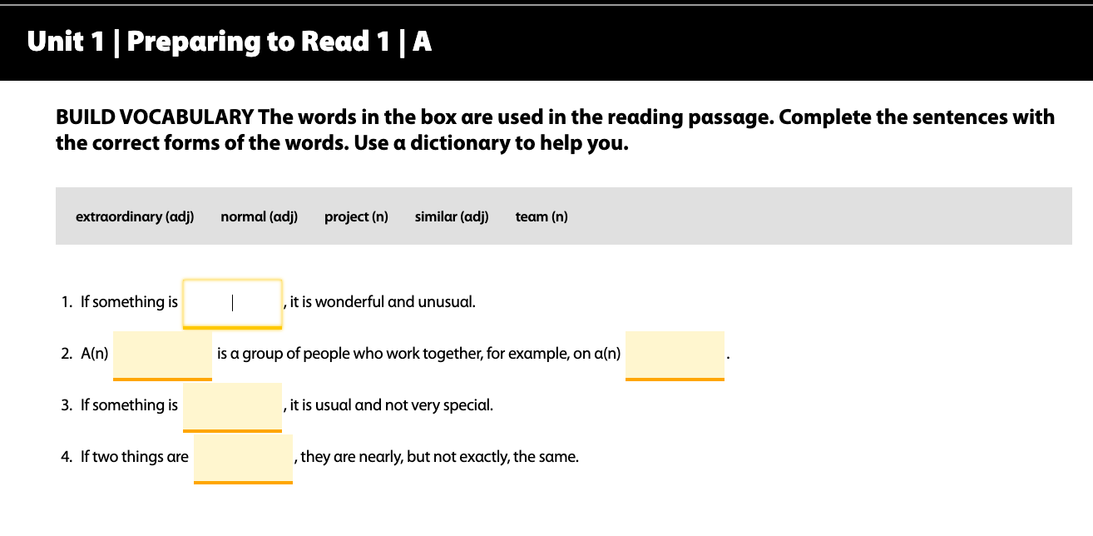

Slide 6
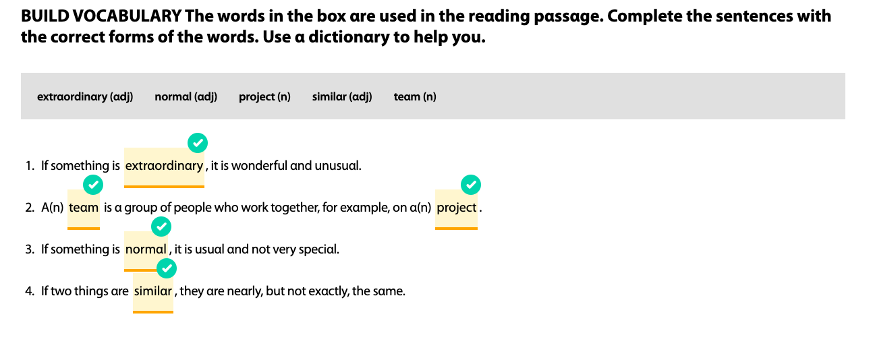

Slide 7
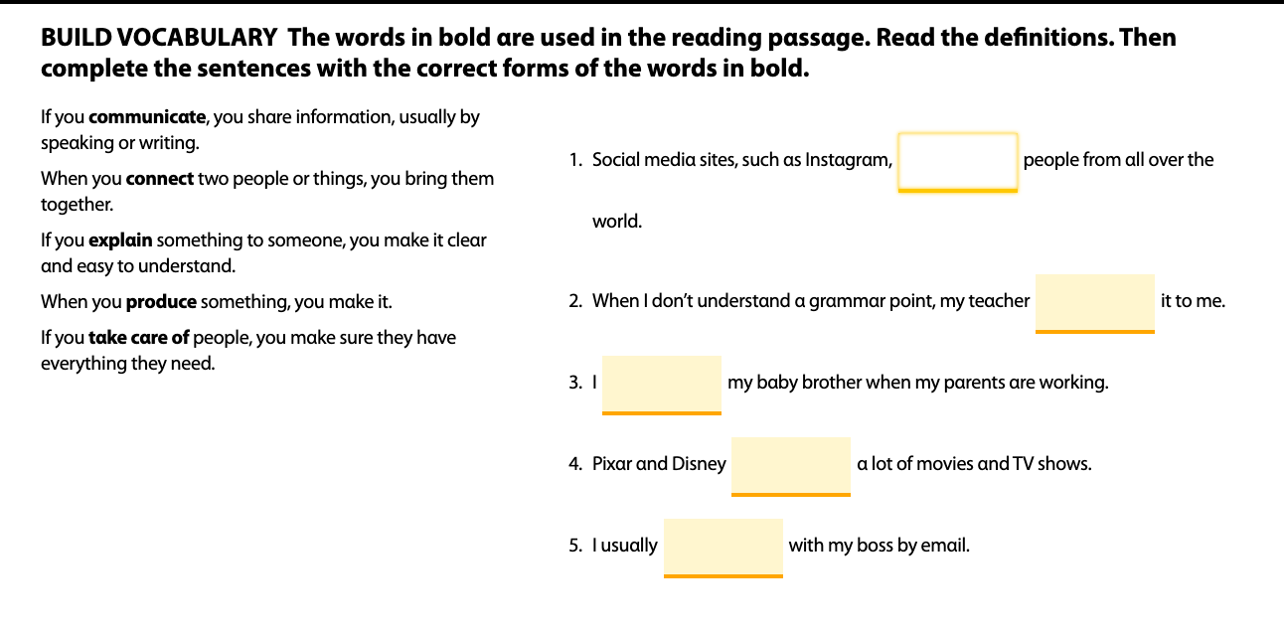

Slide 8
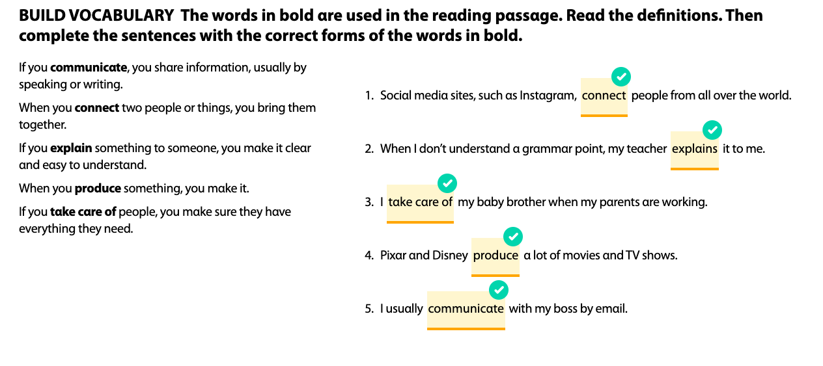

Slide 9
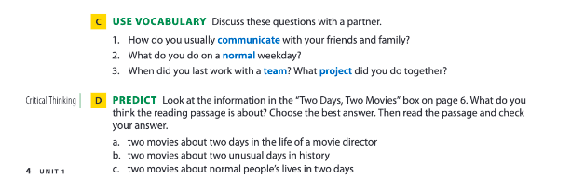

Slide 10

READING 01

Slide 11
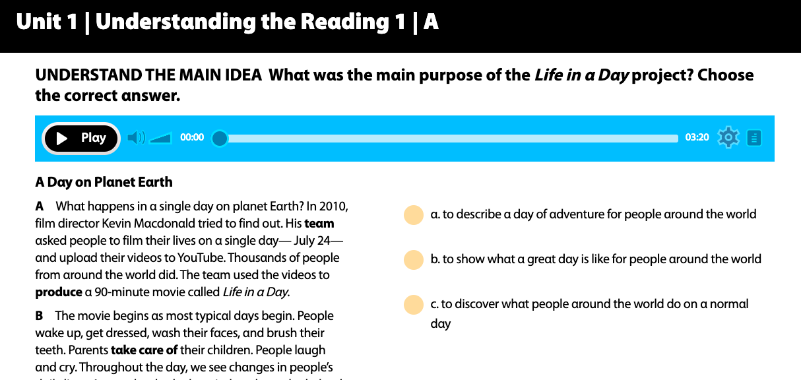

Slide 12
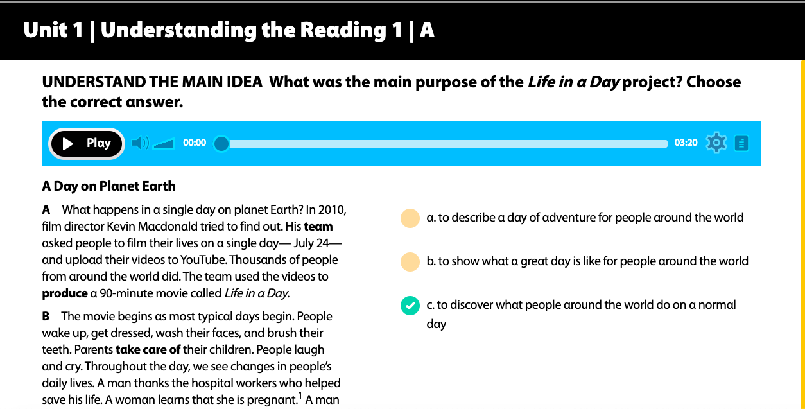

Slide 13
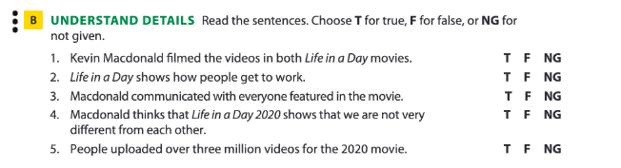

Slide 14
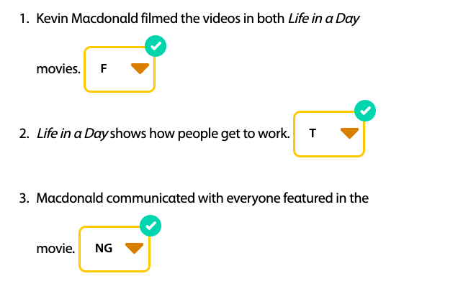
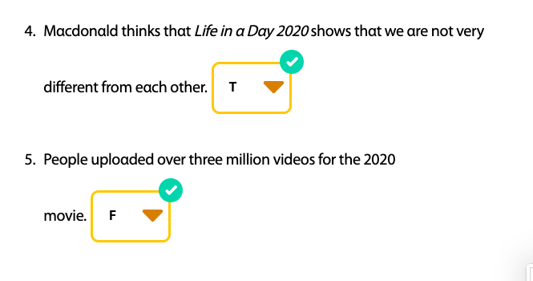

Slide 15
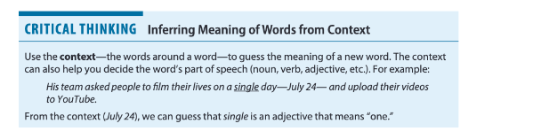

Slide 16
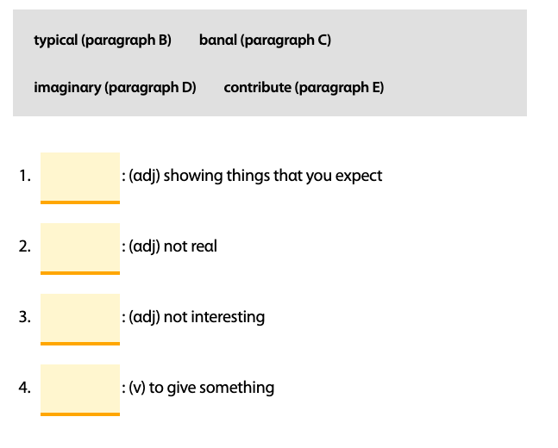

Slide 17
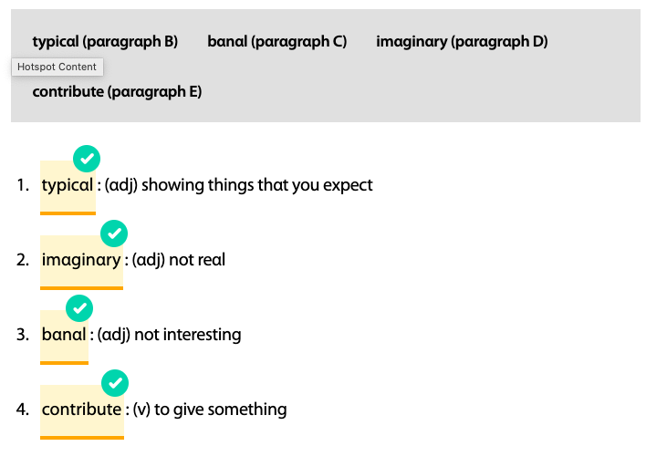

Slide 18
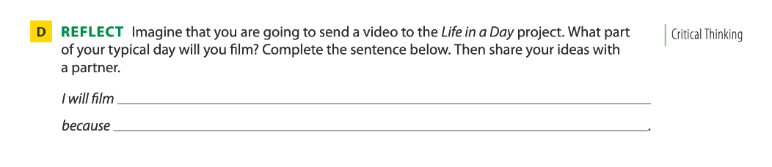

Slide 19
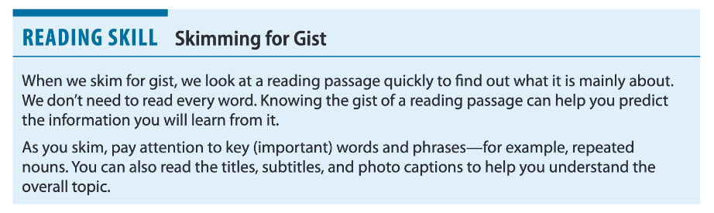

Slide 20
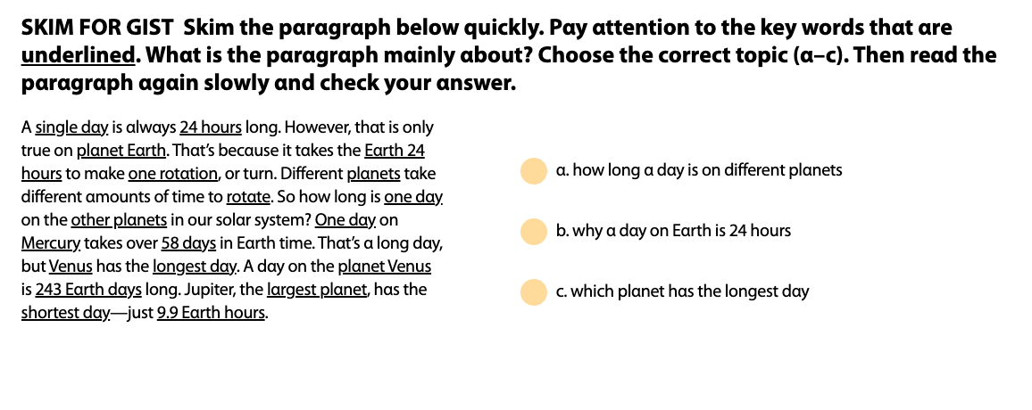

Slide 21


Slide 22
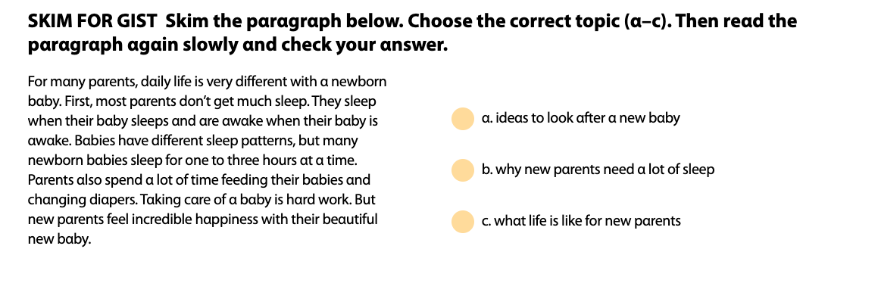

Slide 24

READING 02

Slide 25
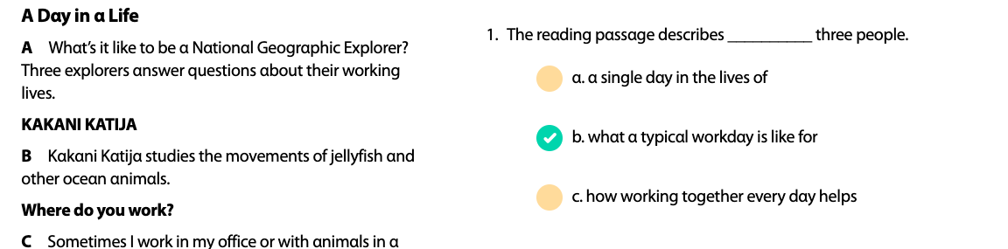

Slide 26
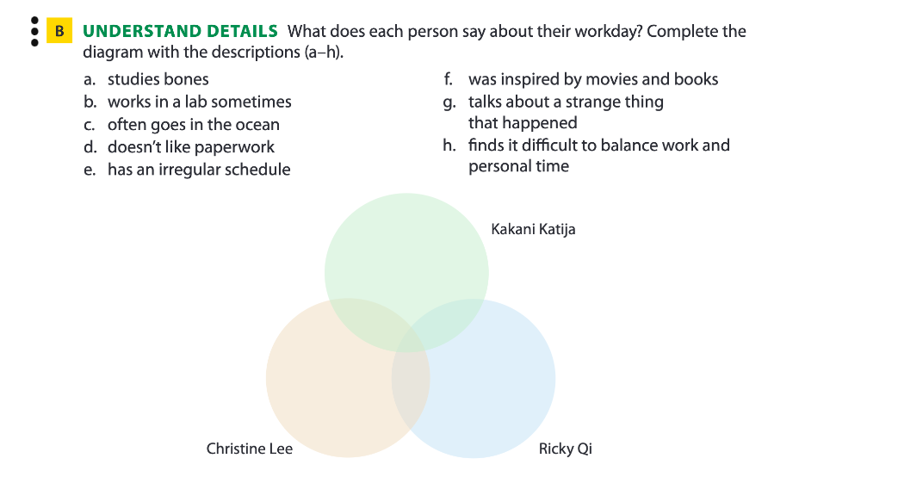

Slide 27
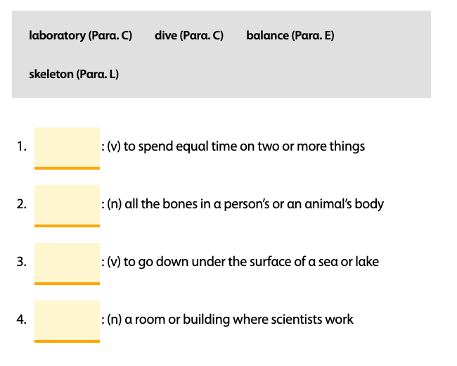

Slide 28
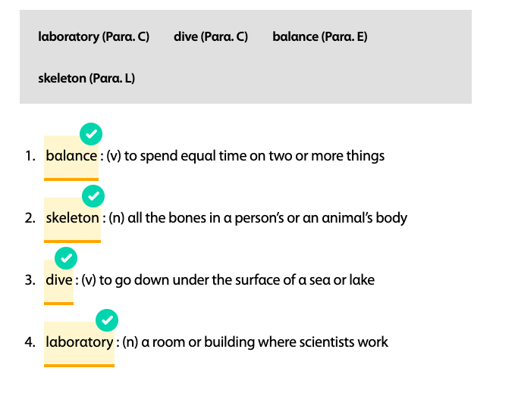

Slide 29
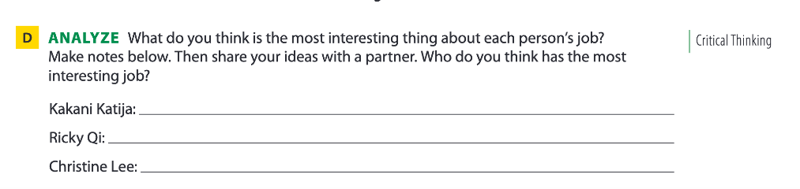

Slide 30
POST-READING
A day in your life (100 words)
Apply vocab & ideas in the 2 reading texts
Share it with the class

